Slide 1
College Technical Math 1
Sections 5.5 - 5.6
Powers of 10, Scientific Notation, Engineering Notation

Slide 2
Essential Question
“Is the application of algebraic concepts a benefit to society?”

Slide 3
Unit 2
3.1/3.2 (1-3): Percentages and Percentage Problems
3.2(4)/3.3: Percentage Problems, Percent Increase and Decrease Problems
5.1 – 5.4: Signed Number Review
5.5/5.6: Powers of 10, Scientific and Engineering Notation

Slide 4

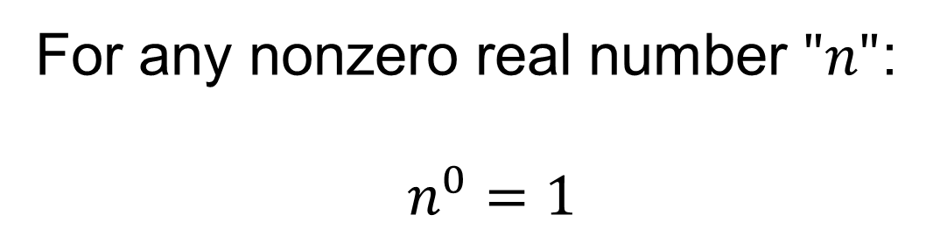


Reciprocals and Negative Exponents
For any nonzero real number $"n"$:
$n^{0}=1$
$$5^{0}=1$$
$${\left(−3\right)}^{0}=1$$
$${10}^{0}=1$$

Slide 5
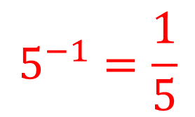
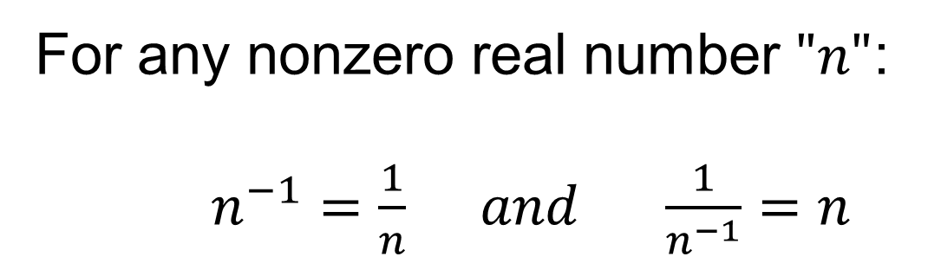
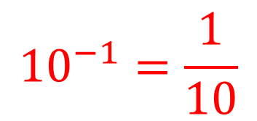
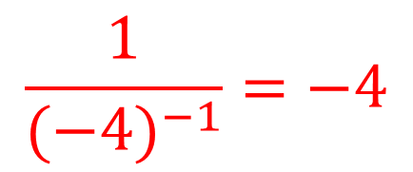
Reciprocals and Negative Exponents
For any nonzero real number $"n"$:
$n^{−1}=\frac{1}{n} and \frac{1}{n^{−1}}=n$
$$5^{−1}=\frac{1}{5}$$
$$\frac{1}{{(−4)}^{−1}}=−4$$
$${10}^{−1}=\frac{1}{10}$$

Slide 6

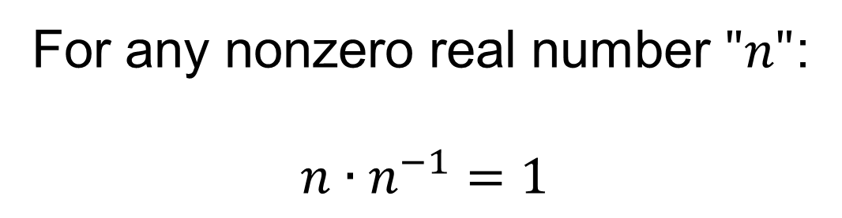

Reciprocals and Negative Exponents
For any nonzero real number $"n"$:
$$n∙n^{−1}=1$$
$$5∙5^{−1}=1$$
$$\left(−3\right){\left(−3\right)}^{−1}=1$$

Slide 7
Redefining the Base 10 Place Values
Using the definitions of zero and negative exponents we can redefine the base 10 place values.

Slide 8
Redefining the Base 10 Place Values
Whole numbers:
The number of zeros in the whole number equals the exponent for the equivalent power of 10.
$$Units = 1={10}^{0}$$
$$Tens = 10={10}^{1}$$
$$Hundreds = 100 ={10}^{2}$$
$$Thousands = 1000={10}^{3}$$
$$Ten thousands = 10,000={10}^{4}$$
$$Hundred thousands = 100,000={10}^{5}$$
$$Millions = 1,000,000={10}^{6}$$
$$Ten millions =10,000,000={10}^{7}$$

Slide 9
Redefining the Base 10 Place Values
Decimals:
The number of place values in the decimal power of ten is equal to the absolute value of the exponent.
$$Tenths =0.1 ={10}^{−1}$$
$$Hundredths =0.01 ={10}^{−2}$$
$$Thousandths =0.001 ={10}^{−3}$$
$$Ten thousandths =0.0001 ={10}^{−4}$$
$$Hundred thousandths=0.00001 ={10}^{−5}$$
$$Millionths =0.000001 ={10}^{−6}$$
$$Ten millionths =0.0000001={10}^{−7}$$

Slide 10
Multiplying and Dividing by Powers of 10
To multiply by a power of 10 with a positive exponent, move the decimal point to the right the number of place values equal to the exponent in the power of 10.

Slide 11
Multiplying and Dividing by Powers of 10
To multiply by a power of 10 with a positive exponent, move the decimal point to the right the number of place values equal to the exponent in the power of 10.
To multiply by a power of 10 with a negative exponent, move the decimal point to the left the number of place values equal to the exponent in the power of 10.

Slide 12




Multiplying and Dividing by Powers of 10
Simplify each product. (Example)
$$a) 275\left(10\right)$$
$$=275.00\left({10}^{1}\right)$$
$$=2750.0$$
$$=2750$$

Slide 13




Multiplying and Dividing by Powers of 10
Simplify each product. (Example)
$$b) 0.18\left(100\right)$$
$$=0.180\left({10}^{2}\right)$$
$$=18.0$$
$$=18$$

Slide 14



Multiplying and Dividing by Powers of 10
Simplify each product. (Example)
$$c) 430\left({10}^{−2}\right)$$
$$=430.0\left({10}^{−2}\right)$$
$$=4.30$$

Slide 15

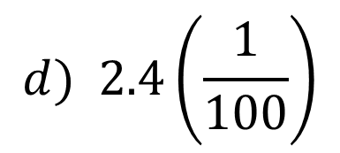

Multiplying and Dividing by Powers of 10
Simplify each product. (Example)
$$d) 2.4\left(\frac{1}{100}\right)$$
$$=2.4\left({10}^{−2}\right)$$
$$=0.024$$

Slide 16



Multiplying and Dividing by Powers of 10
To divide by a power of 10 with a positive exponent, convert the power of 10 to its reciprocal by changing the exponent to its opposite, and then multiply.
$$=\frac{1}{{10}^{2}}$$
$$1÷{10}^{2}$$
$$=1x{10}^{−2}$$

Slide 17


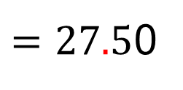

Multiplying and Dividing by Powers of 10
Simplify each quotient. (Example)
$$a) 275÷\left(10\right)$$
$$=275.0\left({10}^{−1}\right)$$
$=27.5$0
$$=27.5$$

Slide 18




Multiplying and Dividing by Powers of 10
Simplify each quotient. (Example)
$$b) 0.18÷\left(100\right)$$
$$=0.180\left({10}^{−2}\right)$$
$$=0.00180$$
$$=0.0018$$

Slide 19


Multiplying and Dividing by Powers of 10
Simplify each product or quotient. (Skill Check)
$$a) 63\left({10}^{3}\right) =63,000$$
$$b) 28\left({10}^{−3}\right) =0.028$$

Slide 20


Multiplying and Dividing by Powers of 10
Simplify each product or quotient. (Skill Check)
$$c) 2400÷\left({10}^{2}\right) =24$$
$$d) 17.3÷\left({10}^{1}\right) =1.73$$

Slide 21

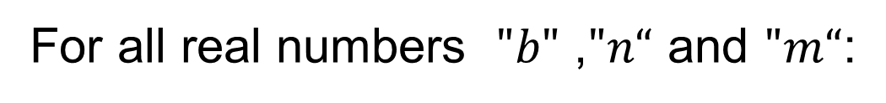
Product Rule of Exponents
For all real numbers $"b"$ ,$"n“$ and $"m“$:
$$b^{n}∙b^{m}=b^{n+m}$$
To multiply exponential expressions with the same base, add the exponents.

Slide 22



Product Rule of Exponents
Simplify each expression. (Example)
$$a) {10}^{5}∙{10}^{3}$$
$$={10}^{5+3}$$
$$={10}^{8}$$

Slide 23



Product Rule of Exponents
Simplify each expression. (Example)
$$b) {10}^{7}∙{10}^{−4}$$
$$={10}^{7+(−4)}$$
$$={10}^{3}$$

Slide 24


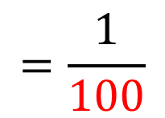
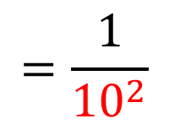

Product Rule of Exponents
Simplify each expression. (Example)
$$c) {10}^{6}∙{10}^{−8}$$
$$={10}^{6+(−8)}$$
$$={10}^{(−2)}$$
$$=\frac{1}{{10}^{2}}$$
$$=\frac{1}{100}$$

Slide 25
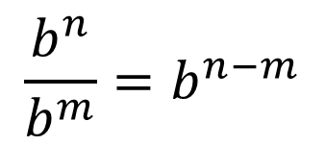
Quotient Rule of Exponents
For all real numbers $"b"$ ,$"n“$ and $"m“$:
$$\frac{b^{n}}{b^{m}}=b^{n−m}$$
To divide exponential expressions with the same base, subtract the exponents.

Slide 26


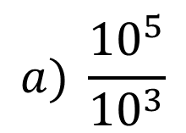

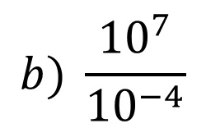

Quotient Rule of Exponents
Simplify each expression. (Example)
$$a) \frac{{10}^{5}}{{10}^{3}}$$
$$={10}^{5−3}$$
$$={10}^{2}$$
$$b) \frac{{10}^{7}}{{10}^{−4}}$$
$$={10}^{7−(−4)}$$
$$={10}^{11}$$

Slide 27

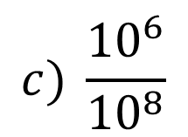

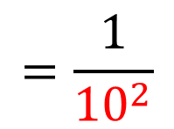

Quotient Rule of Exponents
Simplify each expression. (Example)
$$c) \frac{{10}^{6}}{{10}^{8}}$$
$$=\frac{1}{{10}^{2}}$$
$$=\frac{1}{100}$$
$$={10}^{6−8}$$
$$={10}^{(−2)}$$

Slide 28

Power Rule of Exponents
For all real numbers $"b"$ ,$"n“$ and $"m“$:
$${\left(b^{n}\right)}^{m}=b^{n∙m}$$
To simplify an exponential expression raised to a power, multiply the exponents.

Slide 29






Power Rule of Exponents
Simplify each expression. (Example)
$$a) {\left({10}^{3}\right)}^{2}$$
$$={10}^{(3∙2)}$$
$$={10}^{6}$$
$$b) {\left({10}^{−4}\right)}^{−5}$$
$$={10}^{[\left(−4\right)∙\left(−5\right)]}$$
$$={10}^{20}$$

Slide 30


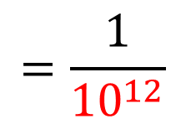

Power Rule of Exponents
Simplify each expression. (Example)
$$=\frac{1}{{10}^{12}}$$
$$c){\left({10}^{3}\right)}^{−4}$$
$$={10}^{3∙(−4)}$$
$$={10}^{(−12)}$$

Slide 31
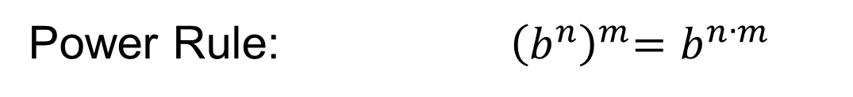
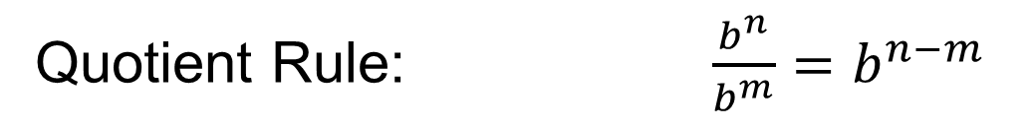
Summary: Properties of Exponents
For any nonzero real number $"n"$: $n^{0}=1$
For any nonzero real number $"n"$:$n∙n^{−1}=1$
Product Rule: $b^{n}∙b^{m}=b^{n+m}$
Quotient Rule: $\frac{b^{n}}{b^{m}}=b^{n−m}$
Power Rule: ${ \left(b^{n}\right)}^{m}=b^{n∙m}$

Slide 32
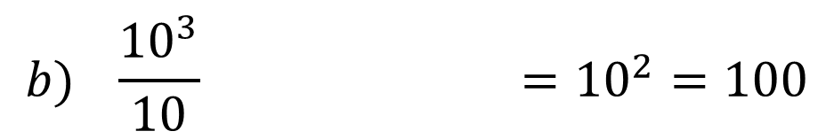

Rules of Exponents
Simplify each expression using the product, quotient or power rules of exponents. (Skill Check)
$$a) ({10}^{7})\left({10}^{3}\right) ={10}^{10}$$
$$b) \frac{{10}^{3}}{10} ={10}^{2}=100$$

Slide 33
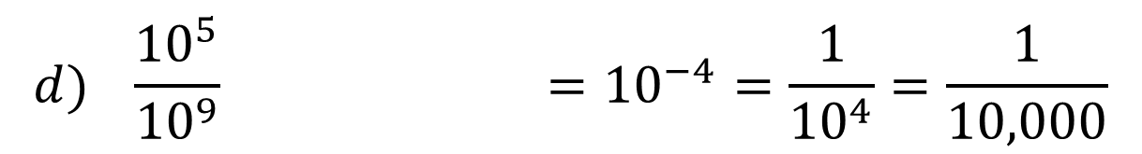

Rules of Exponents
Simplify each expression using the product, quotient or power rules of exponents. (Skill Check)
$$c) {\left({10}^{6}\right)}^{4} ={10}^{24}$$
$$d) \frac{{10}^{5}}{{10}^{9}} ={10}^{−4}=\frac{1}{{10}^{4}}=\frac{1}{10,000}$$

Slide 34
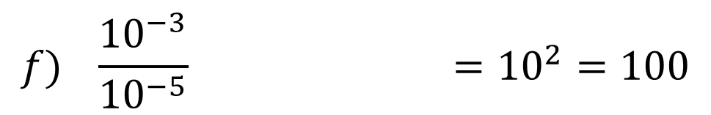

Rules of Exponents
Simplify each expression using the product, quotient or power rules of exponents. (Skill Check)
$$e) ({10}^{−1})\left({10}^{8}\right) ={10}^{7}$$
$$f) \frac{{10}^{−3}}{{10}^{−5}} ={10}^{2}=100$$

Slide 35
Question?
“What is the speed of light in a vacuum in meters per second?”
299,792,458 m/s

Slide 36
Question?
“What is the approximate average distance in meters from the planet Earth to the sun ?”
150,000,000,000 m

Slide 37
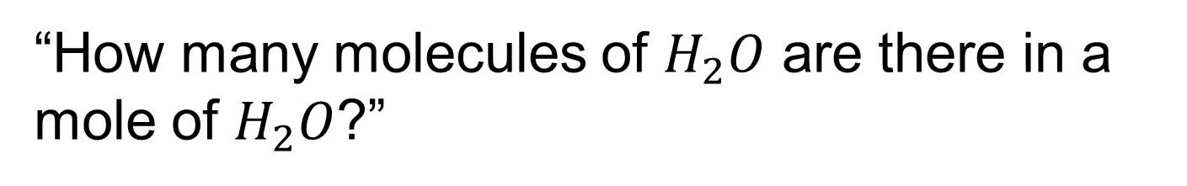
Question?
“How many molecules of $H_{2}O$ are there in a mole of $H_{2}O$?”
60,220,000,000,000,000,000,000

Slide 38
Question?
“What is the diameter of a oxygen atom?”
0.000000000001 m

Slide 39
Scientific Notation
Scientific notation is a method to express large and small numbers as the product of two factors,

Slide 40
Scientific Notation
Scientific notation is a method to express large and small numbers as the product of two factors,
- the first factor is a number whose absolute value is greater than or equal to 1 and less than 10

Slide 41
Scientific Notation
Scientific notation is a method to express large and small numbers as the product of two factors,
- the first factor is a number whose absolute value is greater than or equal to 1 and less than 10
- the second factor is a power of 10.

Slide 42


Scientific Notation
Scientific notation is a method to express large and small numbers as the product of two factors,
- the first factor is a number whose absolute value is greater than or equal to 1 and less than 10
- the second factor is a power of 10.
$$5.46×{10}^{2}$$
$$−7.23×{10}^{−5}$$

Slide 43
Ordinary to Scientific Notation
To convert a number from ordinary(standard) form to scientific notation:

Slide 44
Ordinary to Scientific Notation
To convert a number from ordinary(standard) form to scientific notation:
Move the decimal point to the right of the left-most non-zero digit.

Slide 45
Ordinary to Scientific Notation
To convert a number from ordinary(standard) form to scientific notation:
Move the decimal point to the right of the left-most non-zero digit.
Determine the power of 10 needed to return the value of the original number when multiplied

Slide 46



Ordinary to Scientific Notation
Convert each number to scientific notation. (Example)
$$a) 546$$
$$546.$$
The decimal point needs to move to the left two places.
To return the decimal point to its position in the original number we need to move 2 places in the positive direction.
$$5.46×{10}^{2}$$

Slide 47



Ordinary to Scientific Notation
Convert each number to scientific notation. (Example)
$$b) 0.0073$$
$$0.0073$$
The decimal point needs to move to the right three places.
To return the decimal point to its position in the original number we need to move 3 places in the negative direction.
$$7.3×{10}^{−3}$$

Slide 48




Ordinary to Scientific Notation
(shhhhhhh.....)
SCI
Use “2^{nd”} “SCI” keys
2nd
5
Display:
$$200000$$
$$0.00642$$
SCI
SCI
Buttons:
5
5
2nd
2nd
Display:
$$2 ^{05}$$
$$6.42 ^{−03}$$

Slide 49

Ordinary to Scientific Notation
Convert each number to scientific notation. (Skill Check)
$$a) 234,000 =2.34×{10}^{5}$$
$$b) 0.000019 =1.9×{10}^{−5}$$
$$c) 783.1 =7.831×{10}^{2}$$

Slide 50
Scientific Notation to Ordinary
Converting from scientific notation to ordinary (standard) notation, use the rules of multiplying by a power of 10.
Multiplying by a power of 10 with a positive exponent moves the decimal point to the right the number of places equivalent to the exponent

Slide 51
Scientific Notation to Ordinary
Converting from scientific notation to ordinary (standard) notation, use the rules of multiplying by a power of 10.
Multiplying by a power of 10 with a negative exponent moves the decimal point to the left the number of places equivalent to the exponent

Slide 52


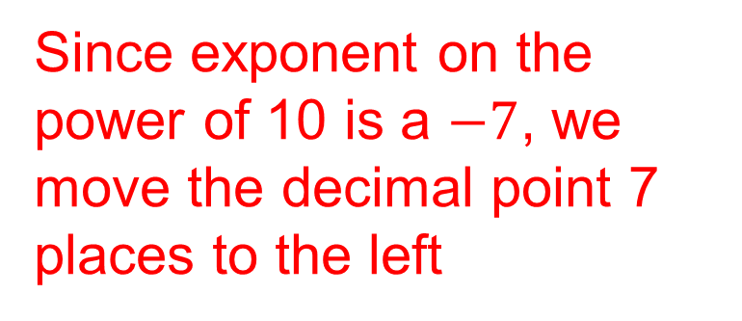
Scientific Notation to Ordinary
Convert each number to ordinary(standard) notation. (Example)
Since exponent on the power of 10 is a $−7$, we move the decimal point 7 places to the left
$$a) 4.7×{10}^{−7}$$
$$0.00000047$$

Slide 53


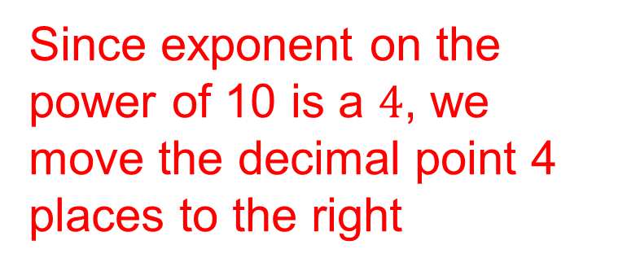
Scientific Notation to Ordinary
Convert each number to ordinary(standard) notation. (Example)
Since exponent on the power of 10 is a $4$, we move the decimal point 4 places to the right
$$b) 6.06×{10}^{4}$$
$$60,600.$$

Slide 54




Ordinary to Scientific Notation
(shhhhhhh.....)
FLO
Use “2^{nd”} “FLO” keys
2nd
4
Display:
$$2 ^{05}$$
$$6.42 ^{−03}$$
SCI
SCI
Buttons:
4
4
2nd
2nd
Display:
$$200000$$
$$0.00642$$

Slide 55



Scientific Notation to Ordinary
Convert each number to ordinary(standard) notation. (Skill Check)
$$a) 7.12×{10}^{5} =712,000$$
$$b) 4. 8×{10}^{−3} =0.0048$$
$$c) 5. 001×{10}^{2} =500.1$$

Slide 56
Multiplying and Dividing Numbers in Scientific Notation
To multiply or divide numbers written in scientific notation:

Slide 57
Multiplying and Dividing Numbers in Scientific Notation
To multiply or divide numbers written in scientific notation:
Multiply(divide) the first factors of each value.

Slide 58
Multiplying and Dividing Numbers in Scientific Notation
To multiply or divide numbers written in scientific notation:
Multiply(divide) the first factors of each value.
Multiply(divide) the powers of 10 using the rules of exponents

Slide 59
Multiplying and Dividing Numbers in Scientific Notation
To multiply or divide numbers written in scientific notation:
Multiply(divide) the first factors of each value.
Multiply(divide) the powers of 10 using the rules of exponents
Convert the product(quotient) to scientific notation

Slide 60
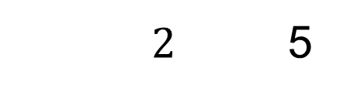
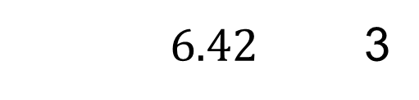




Entering Numbers in Scientific Notation on a Calculator
Use “EE” key
EE
+/-
or
(-)
Number:
$$2×{10}^{5}$$
$$6.42×{10}^{−3}$$
Buttons:
$2$ 5
EE
$6.42$ 3
EE
+/-
Display:
$$2 ^{05}$$
$$6.42 ^{−03}$$

Slide 61

Multiplying and Dividing Numbers in Scientific Notation
Simplify each expression. Write the product or quotient in scientific notation. (Example)
$$a) (4×{10}^{2})(2×{10}^{5})$$

Slide 62


Multiplying and Dividing Numbers in Scientific Notation
Simplify each expression. Write the product or quotient in scientific notation. (Example)
$$a) (4×{10}^{2})(2×{10}^{5})$$
$$8$$

Slide 63



Multiplying and Dividing Numbers in Scientific Notation
Simplify each expression. Write the product or quotient in scientific notation. (Example)
$$a) (4×{10}^{2})(2×{10}^{5})$$
$$8×10^{7}$$
$$8×10^{7}$$

Slide 64


Multiplying and Dividing Numbers in Scientific Notation
Simplify each expression. Write the product or quotient in scientific notation. (Example)
$$a) (4×{10}^{2})(2×{10}^{5})$$
$$8×10^{7}$$

Slide 65

Multiplying and Dividing Numbers in Scientific Notation
Simplify each expression. Write the product or quotient in scientific notation. (Example)
$$b) (6.8×{10}^{−2})(7.3×{10}^{9})$$

Slide 66


Multiplying and Dividing Numbers in Scientific Notation
Simplify each expression. Write the product or quotient in scientific notation. (Example)
$$b) (6.8×{10}^{−2})(7.3×{10}^{9})$$
$$49.64$$

Slide 67


Multiplying and Dividing Numbers in Scientific Notation
Simplify each expression. Write the product or quotient in scientific notation. (Example)
$$b) (6.8×{10}^{−2})(7.3×{10}^{9})$$
$$49.64×{10}^{7}$$

Slide 68



Multiplying and Dividing Numbers in Scientific Notation
Simplify each expression. Write the product or quotient in scientific notation. (Example)
$$b) (6.8×{10}^{−2})(7.3×{10}^{9})$$
$$49.64×{10}^{7}$$
$$(4.964×{10}^{1})×{10}^{7}$$

Slide 69


Multiplying and Dividing Numbers in Scientific Notation
Simplify each expression. Write the product or quotient in scientific notation. (Example)
$$b) (6.8×{10}^{−2})(7.3×{10}^{9})$$
$$49.64×{10}^{7}$$
$$(4.964×{10}^{1})×{10}^{7}$$
$$=4.964×{10}^{8}$$

Slide 70
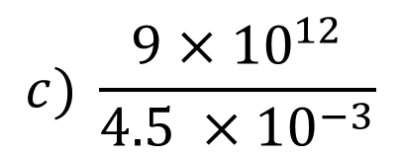
Multiplying and Dividing Numbers in Scientific Notation
Simplify each expression. Write the product or quotient in scientific notation. (Example)
$$c) \frac{9×{10}^{12}}{4.5 ×{10}^{−3}}$$

Slide 71
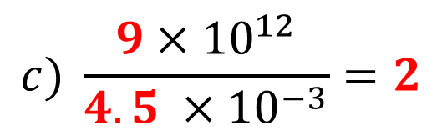
Multiplying and Dividing Numbers in Scientific Notation
Simplify each expression. Write the product or quotient in scientific notation. (Example)
$$c) \frac{9×{10}^{12}}{4.5 ×{10}^{−3}}=2$$

Slide 72
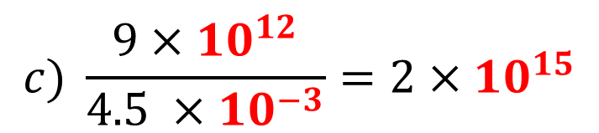
Multiplying and Dividing Numbers in Scientific Notation
Simplify each expression. Write the product or quotient in scientific notation. (Example)
$$c) \frac{9×{10}^{12}}{4.5 ×{10}^{−3}}=2×{10}^{15}$$

Slide 73
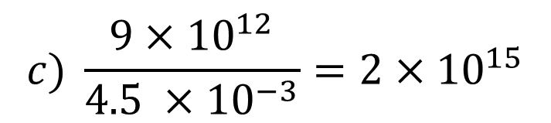
Multiplying and Dividing Numbers in Scientific Notation
Simplify each expression. Write the product or quotient in scientific notation. (Example)
$$c) \frac{9×{10}^{12}}{4.5 ×{10}^{−3}}=2×{10}^{15}$$

Slide 74
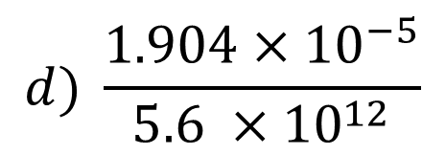
Multiplying and Dividing Numbers in Scientific Notation
Simplify each expression. Write the product or quotient in scientific notation. (Example)
$$d) \frac{1.904×{10}^{−5}}{5.6 ×{10}^{12}}$$

Slide 75
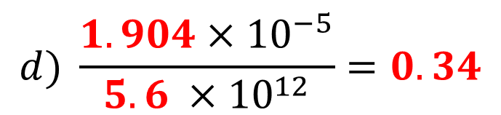
Multiplying and Dividing Numbers in Scientific Notation
Simplify each expression. Write the product or quotient in scientific notation. (Example)
$$d) \frac{1.904×{10}^{−5}}{5.6 ×{10}^{12}}=0.34$$

Slide 76
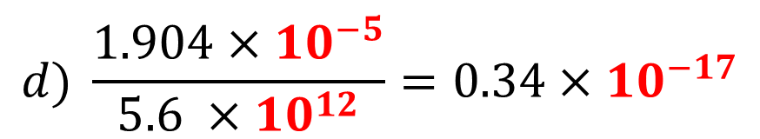
Multiplying and Dividing Numbers in Scientific Notation
Simplify each expression. Write the product or quotient in scientific notation. (Example)
$$d) \frac{1.904×{10}^{−5}}{5.6 ×{10}^{12}}=0.34×{10}^{−17}$$

Slide 77

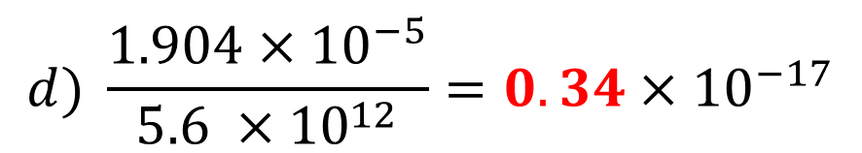
Multiplying and Dividing Numbers in Scientific Notation
Simplify each expression. Write the product or quotient in scientific notation. (Example)
$$d) \frac{1.904×{10}^{−5}}{5.6 ×{10}^{12}}=0.34×{10}^{−17}$$
$$=(3.4×{10}^{−1})×{10}^{−17}$$

Slide 78

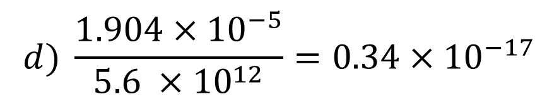

Multiplying and Dividing Numbers in Scientific Notation
Simplify each expression. Write the product or quotient in scientific notation. (Example)
$$d) \frac{1.904×{10}^{−5}}{5.6 ×{10}^{12}}=0.34×{10}^{−17}$$
$$=(3.4×{10}^{−1})×{10}^{−17}$$
$$=3.4×{10}^{−18}$$

Slide 79


Multiplying and Dividing Numbers in Scientific Notation
Simplify each expression. Write the product or quotient in scientific notation. (Example)
$$d) \frac{1.904×{10}^{−5}}{5.6 ×{10}^{12}}=0.34×{10}^{−17}$$
$$=(3.4×{10}^{−1})×{10}^{−17}$$
$$=3.4×{10}^{−18}$$

Slide 80
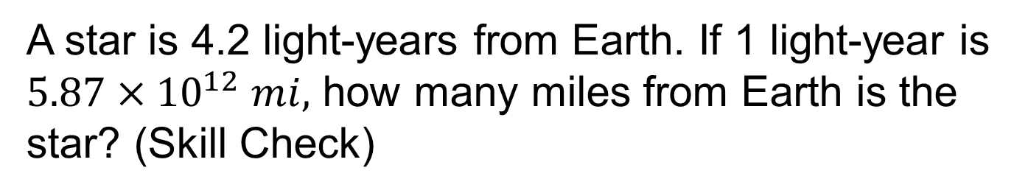
Multiplying and Dividing Numbers in Scientific Notation
A star is 4.2 light-years from Earth. If 1 light-year is $5.87×{10}^{12} mi,$ how many miles from Earth is the star? (Skill Check)
$$4.2\left(5.87×{10}^{12}\right)=24.654×{10}^{12}=2.4654×{10}^{13}$$

Slide 81
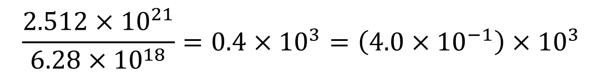
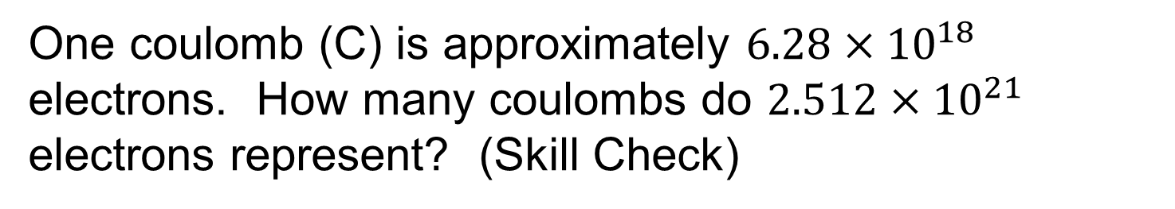

Multiplying and Dividing Numbers in Scientific Notation
One coulomb (C) is approximately $6.28×{10}^{18}$ electrons. How many coulombs do $2.512×{10}^{21}$ electrons represent? (Skill Check)
$$\frac{2.512×{10}^{21}}{6.28×{10}^{18}}=0.4×{10}^{3}=\left(4.0×{10}^{−1}\right)×{10}^{3}$$
$$=4.0×{10}^{2}=400C$$

Slide 82
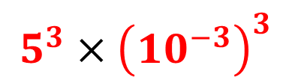
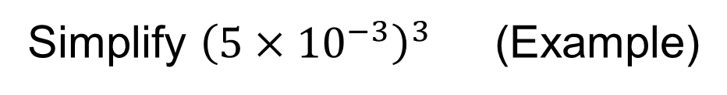
Scientific Notation and Exponents
Simplify ${\left(5×{10}^{−3}\right)}^{3}$ (Example)
$$5^{3}×{\left({10}^{−3}\right)}^{3}$$

Slide 83


Scientific Notation and Exponents
Simplify ${\left(5×{10}^{−3}\right)}^{3}$ (Example)
$$5^{3}×{\left({10}^{−3}\right)}^{3}$$
$$125×{10}^{−9}$$

Slide 84


Scientific Notation and Exponents
Simplify ${\left(5×{10}^{−3}\right)}^{3}$ (Example)
$$5^{3}×{\left({10}^{−3}\right)}^{3}$$
$$125×{10}^{−9}$$
$$(1.25×{10}^{2})×{10}^{−9}$$

Slide 85


Scientific Notation and Exponents
Simplify ${\left(5×{10}^{−3}\right)}^{3}$ (Example)
$$5^{3}×{\left({10}^{−3}\right)}^{3}$$
$$125×{10}^{−9}$$
$$(1.25×{10}^{2})×{10}^{−9}$$
$$1.25×{10}^{−7}$$

Slide 86

Scientific Notation and Exponents
Simplify ${\left(5×{10}^{−3}\right)}^{3}$ (Example)
$$5^{3}×{\left({10}^{−3}\right)}^{3}$$
$$125×{10}^{−9}$$
$$(1.25×{10}^{2})×{10}^{−9}$$
$$1.25×{10}^{−7}$$

Slide 87

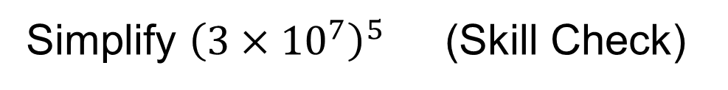



Scientific Notation and Exponents
Simplify ${\left(3×{10}^{7}\right)}^{5}$ (Skill Check)
$$3^{5}×{\left({10}^{7}\right)}^{5}$$
$$243×{10}^{35}$$
$$(2.43×{10}^{2})×{10}^{35}$$
$$2.43×{10}^{37}$$

Slide 88
Unit 2
3.1/3.2 (1-3): Percentages and Percentage Problems
3.2(4)/3.3: Percentage Problems, Percent Increase and Decrease Problems
5.1 – 5.4: Signed Number Review
5.5/5.6: Powers of 10, Scientific and Engineering Notation

